Slide 1
Calcium Wave Project
11.2.15

Slide 2
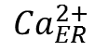
Molecular mechanism of calcium propagation
Ca²⁺
PLC-γ
PIP₂
IP₃
IP₃
Ca²⁺
IP₃
+
+
Ca²⁺
SERCA
-
IP₃R
Gap Junction
Ca²⁺
$${Ca}_{ER}^{2+}$$
ER

Slide 3
Molecular mechanism of calcium propagation
Ca²⁺
PLC-γ
PIP₂
(2)
(6)
IP₃
IP₃
(3)
Ca²⁺
IP₃
(1)
(5)
(8)
+
+
(7)
Ca²⁺
SERCA
-
IP₃R
Gap Junction
Ca²⁺
(4)
$${Ca}_{ER}^{2+}$$
ER

Slide 4




Reaction-diffusion model
$$\frac{∂\left[Ca2\text{+}\right]}{∂t}=k_{flux}\left[IP3R\right]\left(\left[{Ca}_{ER}^{2+}\right]−\left[Ca2\text{+}\right]\right)\left(\frac{\left[IP3\right]n}{k_{μ}n+\left[IP3\right]n}\right)\left(b+\frac{\left(1−b\right)\left[Ca2\text{+}\right]}{k_{1}+\left[Ca2\text{+}\right]}\right)+v_{40}−k_{5}\left[Ca2\text{+}\right]−\frac{γ{\left[Ca2\text{+}\right]}^{2}}{{k_{γ}+\left[Ca2\text{+}\right]}^{2}}+D_{Ca2\text{+}}∇^{2}\left[Ca2\text{+}\right]$$
(1) IP₃ mediated Ca²⁺ release
(2) Constant leak³
(3) Ca²⁺ to
Media³
(4) SERCA
Pump³
(5) Diffusion
$$\frac{d\left[{Ca}_{ER}^{2+}\right]}{dt}=β\left(\frac{γ{\left[Ca2\text{+}\right]}^{2}}{{k_{γ}+\left[Ca2\text{+}\right]}^{2}}−k_{flux}\left[IP3R\right]\left(\frac{\left[IP3\right]n}{k_{μ}n+\left[IP3\right]n}\right)\left(b+\frac{\left(1−b\right)\left[Ca2\text{+}\right]}{k_{1}+\left[Ca2\text{+}\right]}\right)\right)$$
ER Calcium store (derived from conservation of matter)
$$\frac{∂\left[IP3\right]}{∂t}=v_{PLC}N\left(1,σ^{2}\right)−\frac{k_{P}V_{P}\left[IP3\right]}{k_{P}+\left[IP3\right]}+D_{IP3}∇^{2}\left[IP3\right]$$
$$\frac{d\left[IP3R\right]}{dt}=k_{6}\left(\frac{K_{i}^{2}}{{K_{i}^{2}+\left[Ca2\text{+}\right]}^{2}}−\left[IP3R\right]\right)$$
(6) PLC term with stochastic noise
Decay
(7) Diffusion
(8) Calcium-mediated IP₃R inactivation
[1] Bezprozvanny I, Watras J, Ehrlich BE (1991) Bell-shaped calcium response curves of Ins(1, 4, 5)P3 and calcium gated channels from endoplasmic reticulum of the cerebellum. Nature 351:751–754.
[2] Dupont G, Goldbeter A (1993) One-pool model for Ca2+ oscillations involving Ca2+ and inositol 1, 4, 5-trisphosphate as co-agonist for Ca2+ release. Cell Calcium 14:311–322.
[3] Venance L, Stella N, Glowinski J, Giaume C (1997) Mechanism involved in initiation and propagation of receptor-induced intercellular calcium signaling in cultured rat astrocytes. J Neurosci 17:1981–1992.
Notes:
Formal separate PLCg term

Slide 5
OTHER SLIDES

Slide 6
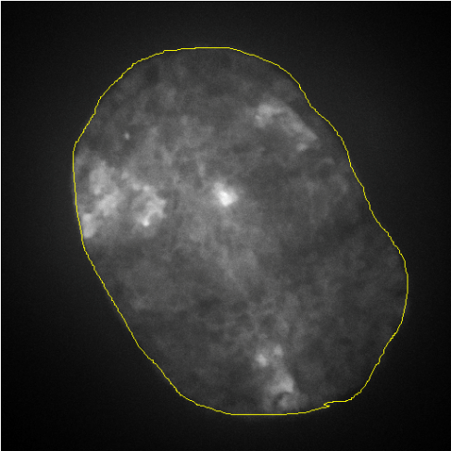
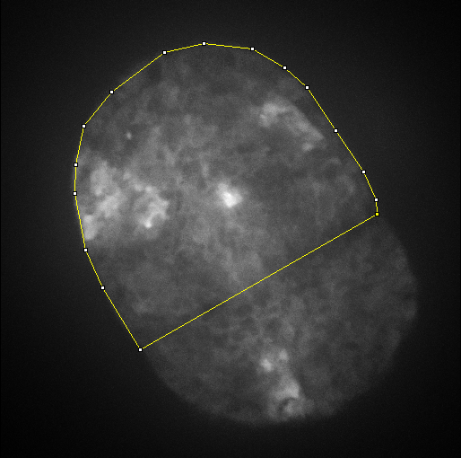
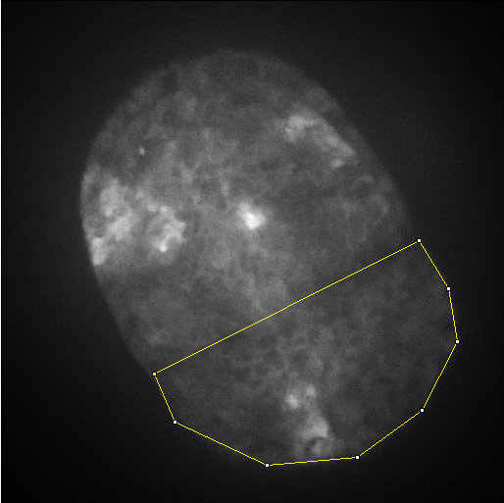
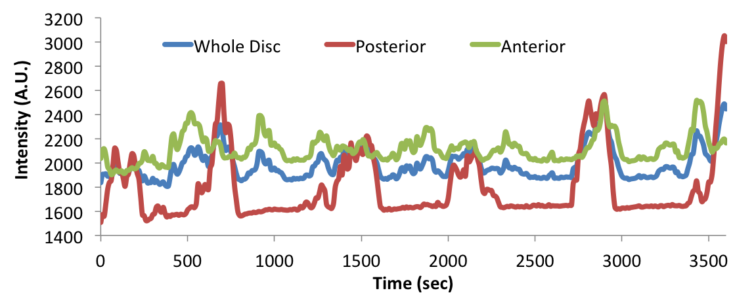
Domain specificity of Ca²⁺ transients
Whole disc
Anterior
Posterior

Slide 7
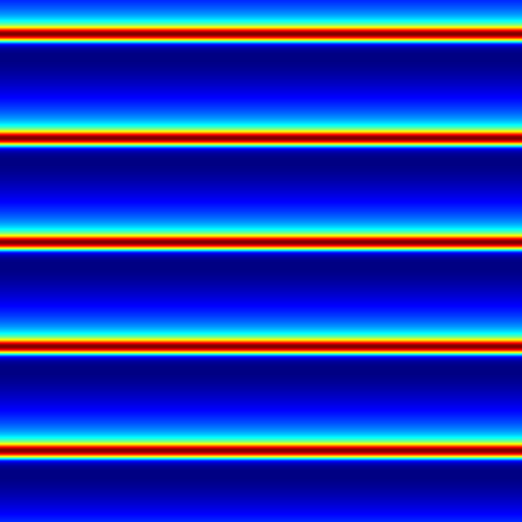
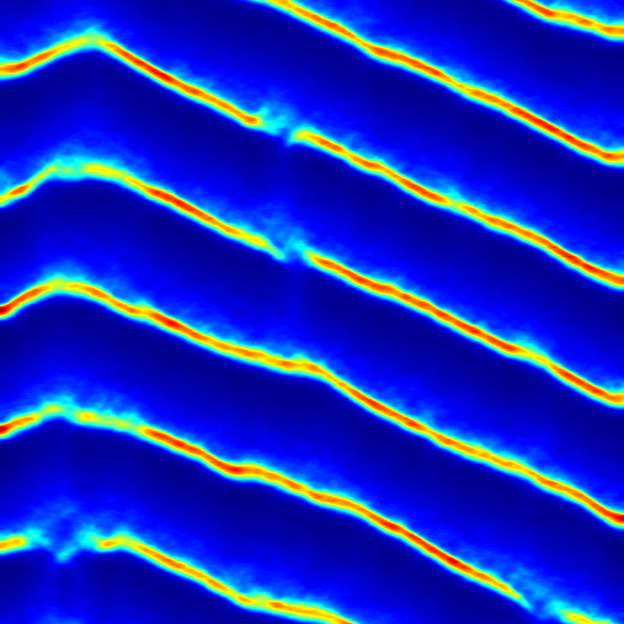
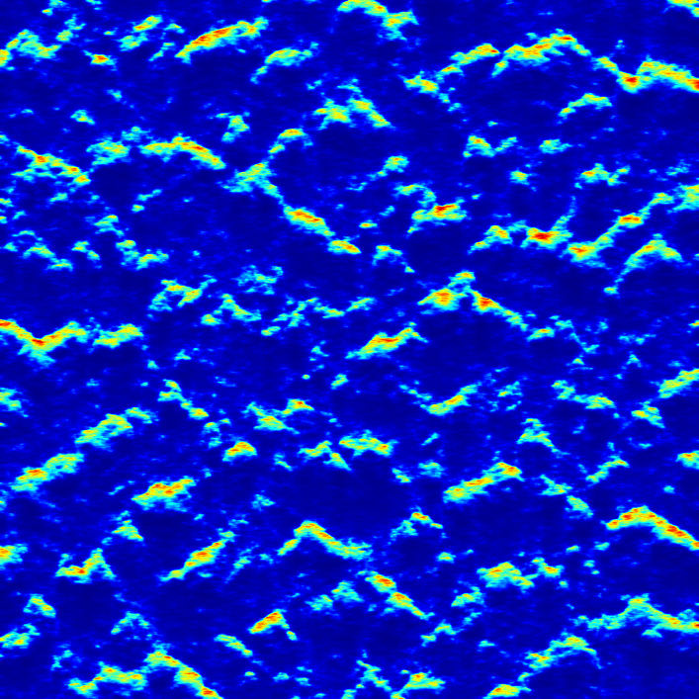
Minor IP₃ perturbations sufficient for generation of self-propagating waves
Position
σ = 0.000
σ = 0.0075
σ = 0.0960
Time
t = 4000 to 5000

Slide 8
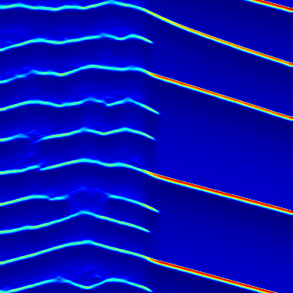
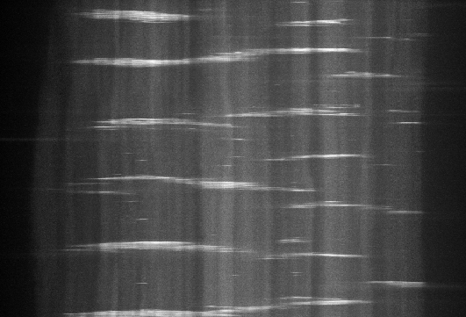
A/P boundary penetrance
Position
v_{ind} = 8.00 x 10⁻³
v_{ind} = 2.00 x 10⁻³
Time
Anterior
Posterior
Anterior
Posterior
Notes:
If refractory period of one compartment is different, sometimes a wave will move through the A/P boundary and sometimes not, resulting in variable frequency. This was observed ex vivo as well.

Slide 9
Molecular mechanism of calcium propagation
Ca²⁺
Mechanical
Stimulation
PLC-γ
PIP₂
+
TRPN Channel
(2)
(9)
(3)
IP₃
IP₃
(4)
Ca²⁺
IP₃
(1)
(6)
(8)
+
+
(7)
Ca²⁺
SERCA
-
IP₃R
Gap Junction
Ca²⁺
(5)
$${Ca}_{ER}^{2+}$$
ER
NEEDS TO BE SYSTEM SPECIFIC

Slide 10
Questions we would like to attack
Are there any physical differences between A and P compartment cells
What are the kinetics of calcium signaling in the wing-disc
Candidates for the identity of the active serum component

Slide 11
Initial attempt with Höfer model
Ca²⁺
Mechanical
Stimulation
PLC-γ
PIP₂
+
TRPN Channel
(2)
(9)
(3)
IP₃
IP₃
(4)
Ca²⁺
IP₃
(1)
(6)
(8)
+
+
(7)
Ca²⁺
SERCA
-
IP₃R
Gap Junction
Ca²⁺
(5)
$${Ca}_{ER}^{2+}$$
ER
NEEDS TO BE SYSTEM SPECIFIC

Slide 12
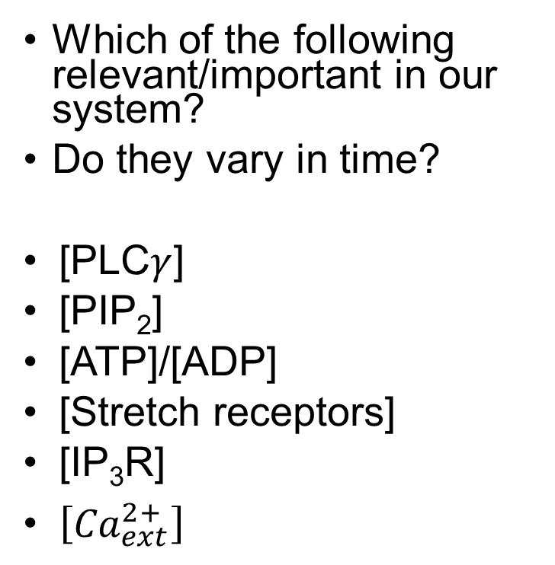
PLC—many potential mechanisms
ATP
Which of the following relevant/important in our system?
Do they vary in time?
[PLC$γ$]
[PIP₂]
[ATP]/[ADP]
[Stretch receptors]
[IP₃R]
$\left[{Ca}_{ext}^{2+}\right]$
ADP
?
?
PLC-γ
PIP₂
?
?
DAG
?
?
?
IP₃
Ca²⁺
?????

Slide 13
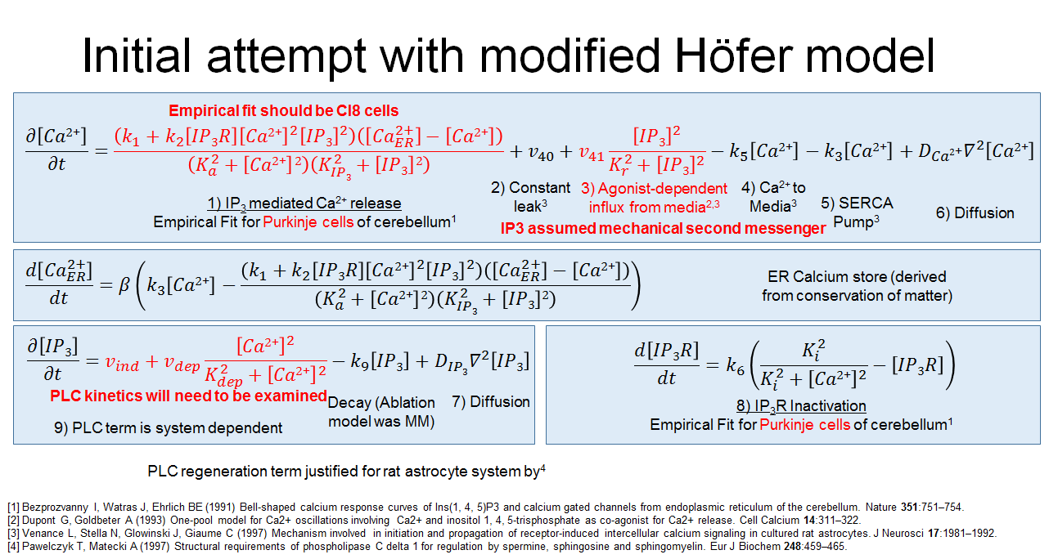

Slide 14




Initial attempt with modified Höfer model
Empirical fit should be Cl8 cells
$$\frac{∂\left[Ca2\text{+}\right]}{∂t}=\frac{\left(k_{1}+k_{2}\left[IP3R\right]{\left[Ca2\text{+}\right]}^{2}{\left[IP3\right]}^{2}\right)\left(\left[{Ca}_{ER}^{2+}\right]−\left[Ca2\text{+}\right]\right)}{\left(K_{a}^{2}+\left[Ca2\text{+}\right]2\right)\left(K_{IP3}^{2}+\left[IP3\right]2\right)}+v_{40}+v_{41}\frac{{\left[IP3\right]}^{2}}{{K_{r}^{2}+\left[IP3\right]}^{2}}−k_{5}\left[Ca2\text{+}\right]−k_{3}\left[Ca2\text{+}\right]+D_{Ca2\text{+}}∇^{2}\left[Ca2\text{+}\right]$$
2) Constant leak³
3) Agonist-dependent influx from media^{2,3}
4) Ca²⁺ to
Media³
1) IP₃ mediated Ca²⁺ release
Empirical Fit for Purkinje cells of cerebellum¹
5) SERCA
Pump³
6) Diffusion
IP3 assumed mechanical second messenger
$$\frac{d\left[{Ca}_{ER}^{2+}\right]}{dt}=β\left(k_{3}\left[Ca2\text{+}\right]−\frac{\left(k_{1}+k_{2}\left[IP3R\right]{\left[Ca2\text{+}\right]}^{2}{\left[IP3\right]}^{2}\right)\left(\left[{Ca}_{ER}^{2+}\right]−\left[Ca2\text{+}\right]\right)}{\left(K_{a}^{2}+\left[Ca2\text{+}\right]2\right)\left(K_{IP3}^{2}+\left[IP3\right]2\right)}\right)$$
ER Calcium store (derived from conservation of matter)
$$\frac{∂\left[IP3\right]}{∂t}=v_{ind}+v_{dep}\frac{{\left[Ca2\text{+}\right]}^{2}}{{K_{dep}^{2}+\left[Ca2\text{+}\right]}^{2}}−k_{9}\left[IP3\right]+D_{IP3}∇^{2}\left[IP3\right]$$
$$\frac{d\left[IP3R\right]}{dt}=k_{6}\left(\frac{K_{i}^{2}}{{K_{i}^{2}+\left[Ca2\text{+}\right]}^{2}}−\left[IP3R\right]\right)$$
PLC kinetics will need to be examined
Decay (Ablation model was MM)
7) Diffusion
8) IP₃R Inactivation
Empirical Fit for Purkinje cells of cerebellum¹
9) PLC term is system dependent
PLC regeneration term justified for rat astrocyte system by⁴
[1] Bezprozvanny I, Watras J, Ehrlich BE (1991) Bell-shaped calcium response curves of Ins(1, 4, 5)P3 and calcium gated channels from endoplasmic reticulum of the cerebellum. Nature 351:751–754.
[2] Dupont G, Goldbeter A (1993) One-pool model for Ca2+ oscillations involving Ca2+ and inositol 1, 4, 5-trisphosphate as co-agonist for Ca2+ release. Cell Calcium 14:311–322.
[3] Venance L, Stella N, Glowinski J, Giaume C (1997) Mechanism involved in initiation and propagation of receptor-induced intercellular calcium signaling in cultured rat astrocytes. J Neurosci 17:1981–1992.
[4] Pawelczyk T, Matecki A (1997) Structural requirements of phospholipase C delta 1 for regulation by spermine, sphingosine and sphingomyelin. Eur J Biochem 248:459–465.
Notes:
Formal separate PLCg term

Slide 15
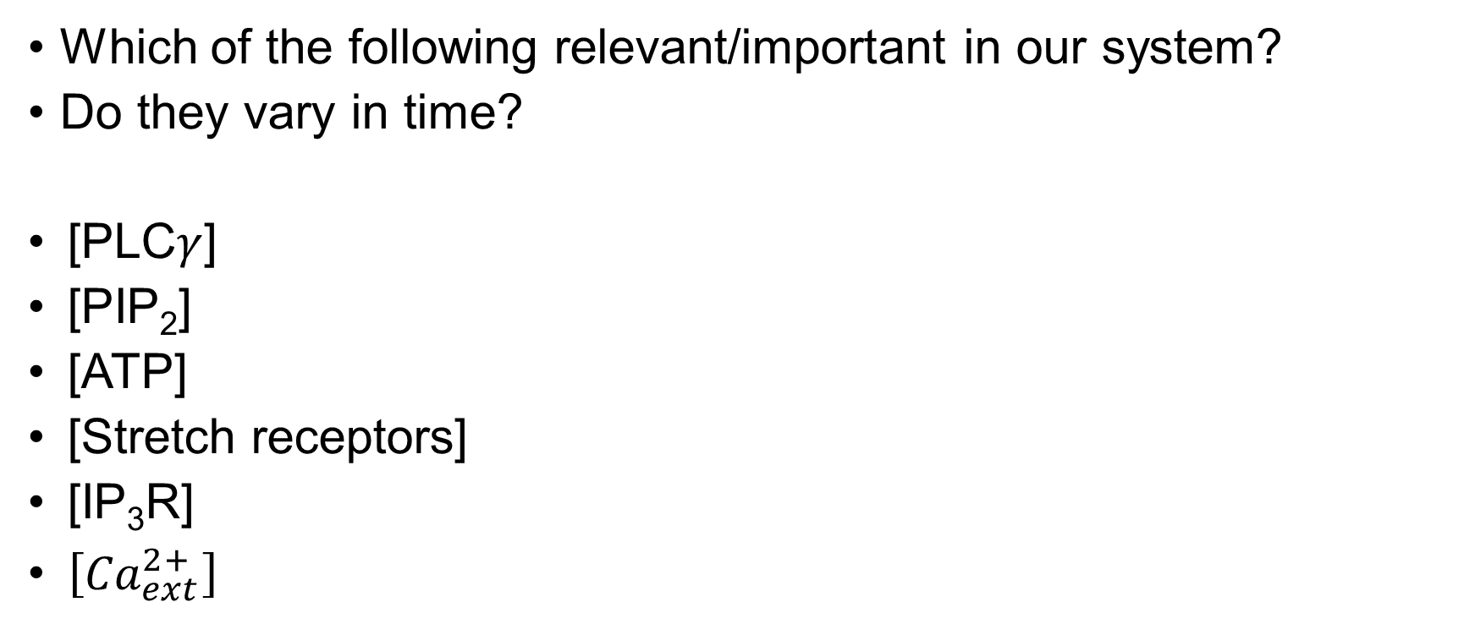
Potentially unreasonable assumptions in the original model: all assumed constant
Which of the following relevant/important in our system?
Do they vary in time?
[PLC$γ$]
[PIP₂]
[ATP]
[Stretch receptors]
[IP₃R]
$\left[{Ca}_{ext}^{2+}\right]$

Slide 16
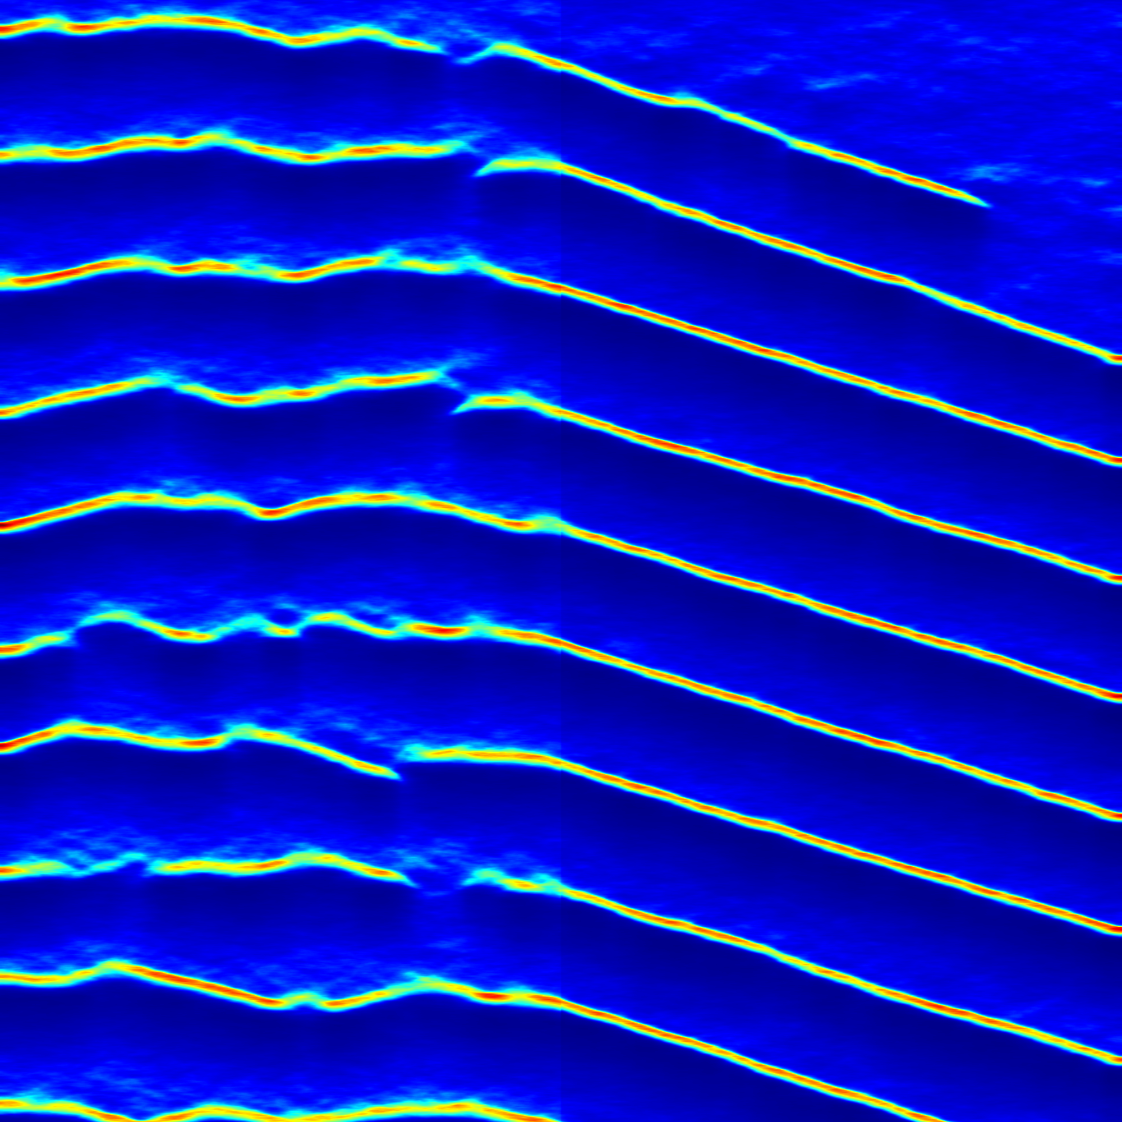
Observations
For several parameter combinations (v41, k1, k3) one side “wins” such that one side gets traveling waves and the other results in pulses
This implies that the parameter should be constant across both compartments since we do not observe this ex vivo.
Position
v₄₁ = 0.200
v₄₁ = 0.048
Time

Slide 17
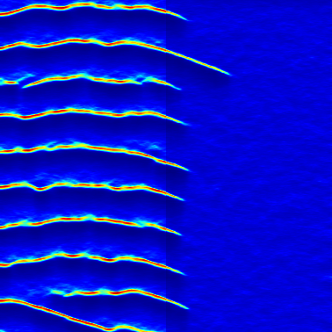
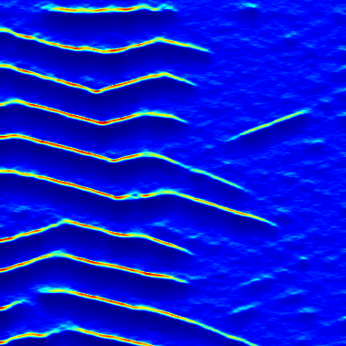
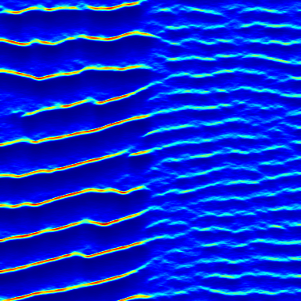
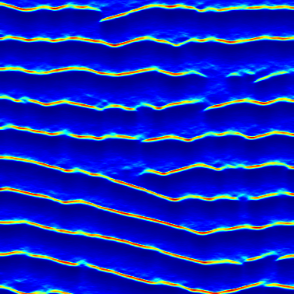
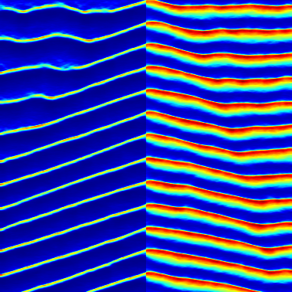
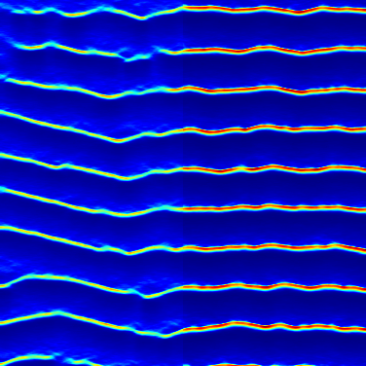
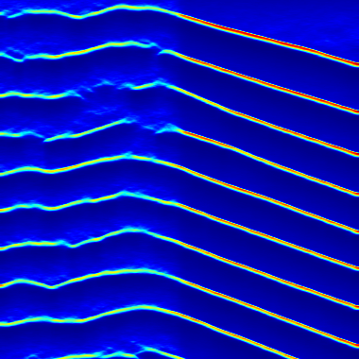
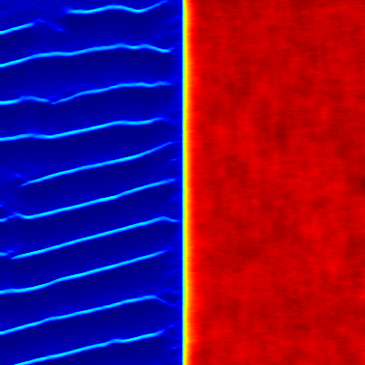
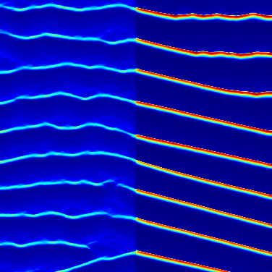
Preliminary parameter sweep
Position
k₅ = 0.595
k₁ = 4.84 x 10⁻⁴
v_{ind} = 1.05 x 10⁻²
v_{ind} = 8.00 x 10⁻³
v_{ind} = 2.00 x 10⁻³
Base Case
k₅ = 0.310
k₁ = 2.29 x 10⁻⁴
v_{ind} = 4.50 x 10⁻³
Time
k₅ = 0.215
k₁ = 1.275 x 10⁻⁵
v_{ind} = 2.00 x 10⁻³
Terms: k₅, k₉, v₄₀, K_{dep},
k₁, k₃, v₄₁,
v_{ind}, k₂,

Slide 18
Summary
We would like to explain the emergence of a transmitted wave regime in the wing imaginal disc
Our assumed PLC-γ/IP₃R kinetics may not be correct for our system
Several simulation observations seem to match experimental observations we have made

